Slide 1
CS 331
Topic: Exceptions and Templates Part 2
MD Romael Haque

Slide 2
Multiple Exceptions
The programs we have studied so far test only for a single type of error and throw only a single type of exception.
In many cases, a program will need to test for several different types of errors and signal which one has occurred.
C++ allows you to throw and catch multiple exceptions.
The only requirement is that each different exception be of a different type.
You then code a separate catch block for each type of exception that may be thrown in the try block.

Slide 3
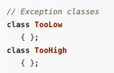
Multiple Exceptions
For example, suppose we wish to expand the IntRange class so that it throws one type of exception if the user enters a value that is too low, and another type if the user enters a value that is too high.
First, we declare two different exception classes, such as
An instance of the TooLow class will be thrown when the user enters a low value, and an instance of the TooHigh class will be thrown when a high value is entered.

Slide 4

Multiple Exceptions
Now, we modify the getInput member function to perform the two error tests and throw the appropriate exception:

Slide 5
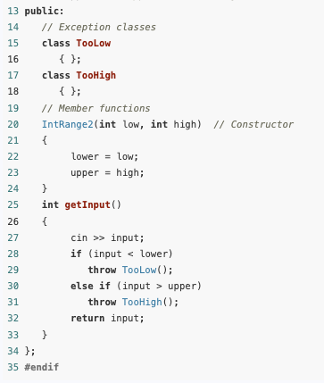
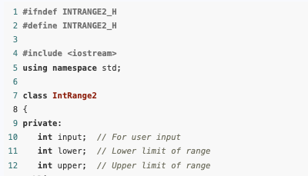
Contents of IntRange2.h

Slide 6
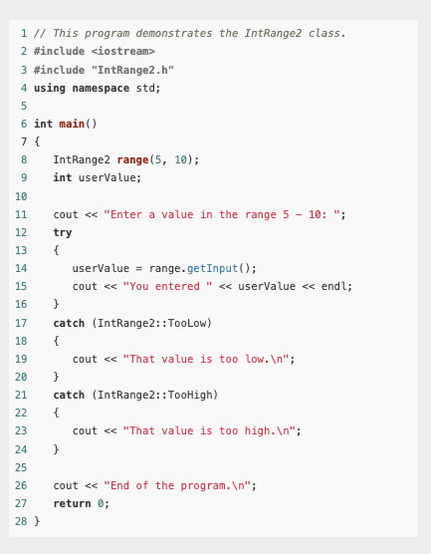
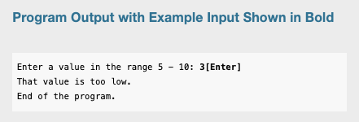
Main()

Slide 7
Extracting Information from the Exception Class
Sometimes we might want an exception to pass information back to the exception handler.
For example, suppose we would like the IntRange class not only to signal when an invalid value has been entered, but to pass the value back.
This can be accomplished by giving the exception class members in which information can be stored

Slide 8
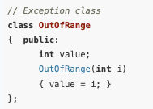
Extracting Information from the Exception Class
IntRange3, our next modification of the IntRange class, again uses a single exception class: OutOfRange.
This version of OutOfRange, however, has a member variable and a constructor that initializes it:

Slide 9
Extracting Information from the Exception Class
When we throw this exception, we want to pass the value entered by the user to the OutOfRange’s constructor.
This is done with the following statement:
This throw statement creates an instance of the OutOfRange class and passes a copy of the input variable to the constructor.
The constructor then stores this number in OutOfRange’s member variable value.
The class instance carries this member variable to the catch block that intercepts the exception.

Slide 10
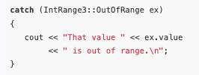
Extracting Information from the Exception Class
Back in the catch block, the value is extracted:
Notice that the catch block declares a parameter object named ex.
This is necessary because the exception has a member variable that we want to examine.

Slide 11
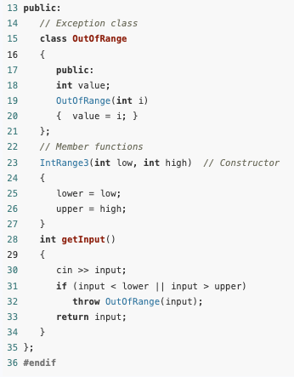
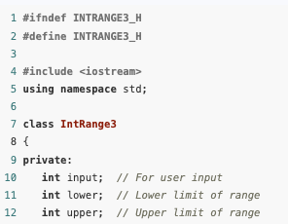
Contents of IntRange3.h

Slide 12
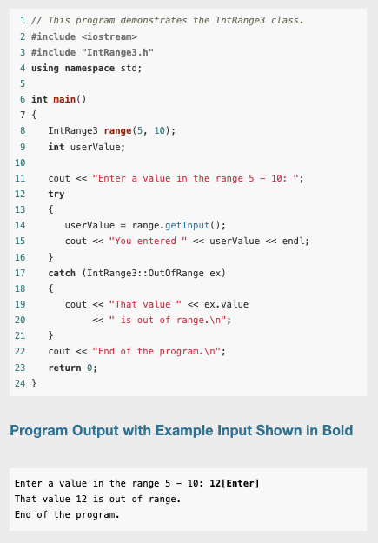
Main()

Slide 13
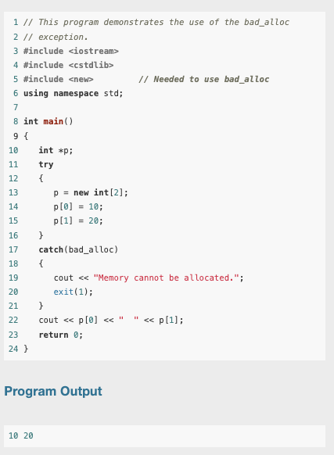
Handling the bad_alloc Exception Thrown by new
The new operator throws a system-defined exception of type bad_alloc if it is unable to allocate the requested storage.
For example, this program attempts to allocate an array of two integers using the new operator inside a try block.

Slide 14
Handling the bad_alloc Exception Thrown by new
If the allocation fails, the resulting bad_alloc exception is caught in the attached catch block and the program is terminated with an appropriate error message.
If the allocation succeeds, the program proceeds to print the two numbers 10 and 20.
The bad_alloc type is defined in the header file new, which must be included in programs that refer to it.

Slide 15
Unwinding the Stack
If an exception is thrown in a try block that has a catch block capable of handling the exception, control transfers from the throw point to the catch block.
Assuming that the catch block executes to completion without throwing further exceptions, returning from the function, or terminating the program, execution will continue at the first statement after the sequence of catch blocks attached to the try block.

Slide 16
Unwinding the Stack
If the function does not contain a catch block capable of handling the exception, control passes out of the function, and the exception is automatically rethrown at the point of the call in the calling function.
By this process, an exception can propagate backwards along the chain of function calls until the exception is thrown out of a try block that has a catch block that can handle it.
If no such try block is ever found, the exception will eventually be thrown out of the main function, causing the program to be terminated.
This process of propagating uncaught exceptions from a function to its caller is called unwinding the stack of function calls.

Slide 17
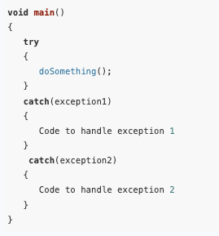
Rethrowing an Exception
It is possible for try blocks to be nested.
For example, look at this code segment:
In this try block, the function doSomething is called.
There are two catch blocks, one that handles exception1 and another that handles exception2.
If the doSomething function contains a try block, then it is nested inside the one shown.

Slide 18
Rethrowing an Exception
With nested try blocks, it is sometimes necessary for an inner exception handler to pass an exception to an outer exception handler.
Sometimes, both an inner and an outer catch block must perform operations when a particular exception is thrown.
These situations require that the inner catch block rethrow the exception so the outer catch block can catch it.

Slide 19
Rethrowing an Exception
A catch block can rethrow an exception with the throw; statement with no parameter.
For example, suppose the doSomething function (called in the try block above) executes code that potentially can throw exception1 or exception3.
Suppose we do not want to handle the exception1 error in doSomething, but instead want to rethrow it to the outer block

Slide 20
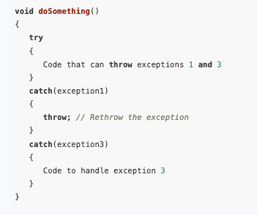
Rethrowing an Exception
When the first catch block catches exception1, the throw; statement simply throws the exception again.
The catch block in the outer try/catch construct, in this case the one in the main function, will then handle the exception.

Slide 21
Function Templates
A function template is a “generic” function that can work with different data types.
The programmer writes the specifications of the function but substitutes parameters for data types.
When the compiler encounters a call to the function, it generates code to handle the specific data type(s) used in the call.

Slide 22
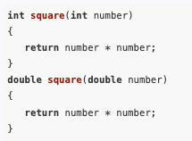
Function Templates
Overloaded functions make programming convenient because only one function name must be remembered for a set of functions that perform similar operations.
Each of the functions, however, must still be written individually.
For example, consider the following overloaded square functions.

Slide 23
Function Templates
The only differences between these two functions are the data types of their return values and their parameters.
In situations like this, it is more convenient to write a function template than an overloaded function.
Function templates allow you to write a single function definition that works with many different data types, instead of having to write a separate function for each data type used.

Slide 24
Function Templates
A function template is not an actual function, but a “mold” the compiler uses to generate one or more functions.
When writing a function template, you do not have to specify actual types for the parameters, return value, or local variables.
Instead, you use a type parameter to specify a generic data type.
When the compiler encounters a call to the function, it examines the data types of its arguments and generates the function code that will work with those data types.

Slide 25
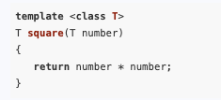
Function Templates
Here is a function template for the square function:
The beginning of a function template is marked by a template prefix, which begins with the key word template.

Slide 26
Function Templates
Next is a set of angled brackets that contain one or more generic data types used in the template.
A generic data type starts with the key word class, followed by a parameter name that stands for the data type.
The example just given only uses one, which is named T. (If there were more, they would be separated by commas.)

Slide 27
Function Templates
After this, the function definition is written as usual, except the type parameters are substituted for the actual data type names.
In the example, the function header reads T square(T number)
T is the type parameter, or generic data type.
The header defines square as a function that returns a value of type T and uses a parameter, number, which is also of type T.

Slide 28


Function Templates
As mentioned before, the compiler examines each call to square and fills in the appropriate data type for T.
For example, the following call uses an int argument:
This code will cause the compiler to generate the function:

Slide 29
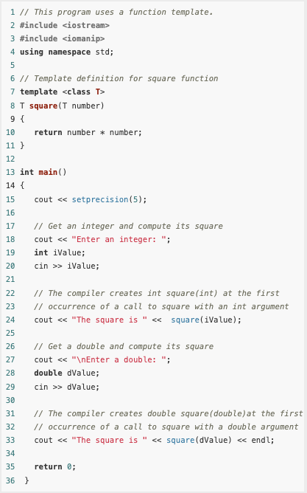
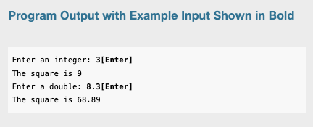
Complete example

Slide 30
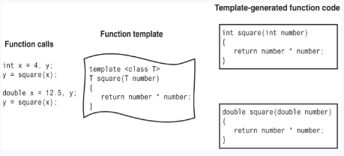
Function Templates
Since the compiler encountered two calls to square in the previous example, each with different parameter types, it generated the code for two instances of the function: one with an int parameter and int return type, the other with a double parameter and double return type.

Slide 31
Function Templates
Notice that the template appears before all calls to square.
As with regular functions, the compiler must already know the template’s contents when it encounters a call to the template function.
Templates, therefore, should be placed near the top of the program or in a header file.
A function template is merely the specification of a function and by itself does not cause memory to be used.
An actual instance of the function is created in memory when the compiler encounters a call to the template function.

Slide 32
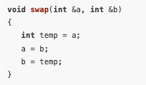
The swap Function Template
In many applications, there is a need for swapping the contents of two variables of the same type.
For example, while sorting an array of integers, there would be a need for the function

Slide 33
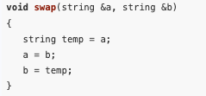
The swap Function Template
whereas while sorting an array string objects, there would be a need for the function
Because the only difference in the coding of these two functions is the type of the variables being swapped, the logic of both functions and all others like them can be captured with one template function.

Slide 34
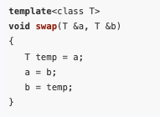
The swap Function Template
Here’s how we can do it:
Such a template function is available in the libraries that come with standard C++ compilers.
The function is declared in the algorithm header file.
#include <algorithm>

Slide 35
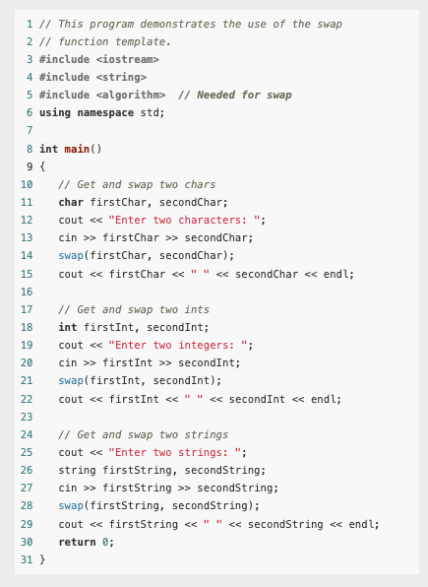
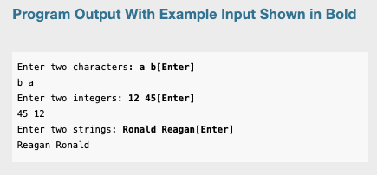
Example

Slide 36
Using Operators in Function Templates
The square function template shown earlier in this section applies the operator * to its parameter.
The square template will work correctly as long as the type of the parameter passed to it supports the * operator.
For example, it works for numeric types such as int, long, and double because all these types have a multiplication operator *.
In addition, the square template will work with any user-defined class type that overloads the operator *.
Errors will result if square is used with types that do not support the operator *.

Slide 37
Function Templates with Multiple Types
More than one generic type may be used in a function template.
We will now see an example where a function that takes as parameters a list of three values of any printable type, prints out the list in order, and then prints out the list in reverse.
The type parameters for the template function are represented using the identifiers T1, T2, and T3.

Slide 38
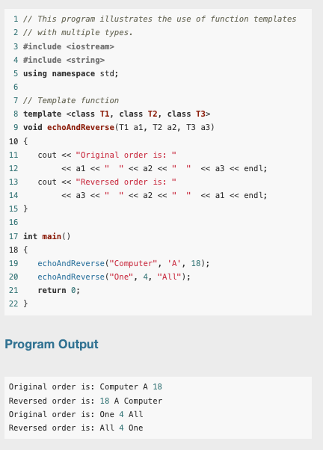
Example
Note: Each type parameter declared in the template prefix must be used somewhere in the template definition.

Slide 39
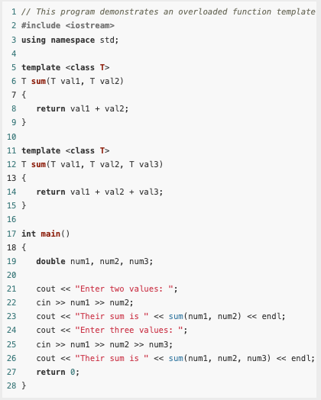
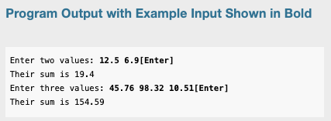
Overloading with Function Templates
Function templates may be overloaded.
As with regular functions, function templates are overloaded by having different parameter lists.

Slide 40
Overloading with Function Templates
There are other ways to perform overloading with function templates as well.
For example, a program might contain a regular (nontemplate) version of a function as well as a template version.
As long as each has a different parameter list, they can coexist as overloaded functions.

Slide 41
Defining Template Functions
In defining template functions, it may be helpful to start by writing a nontemplate version of the function and then converting it to a template after it has been tested.
The conversion is then achieved by prefixing the function definition with an appropriate template header, say template <class T>
And then systematically replacing the relevant type with the generic type T.

Slide 42
Class Templates
Templates may also be used to create generic classes
Function templates are used whenever we need several different functions that have the same problem-solving logic, but differ only in the types of the parameters they work with.
Class templates can be used whenever we need several classes that only differ in the types of some of their data members or in the types of the parameters of their member functions.

Slide 43
Class Templates
Declaring a class template is similar to declaring a function template: You write the class using identifiers such as T, T1, T2 (or whatever other identifier you choose) as generic types, and then you prefix the class declaration with an appropriately written template header.

Slide 44
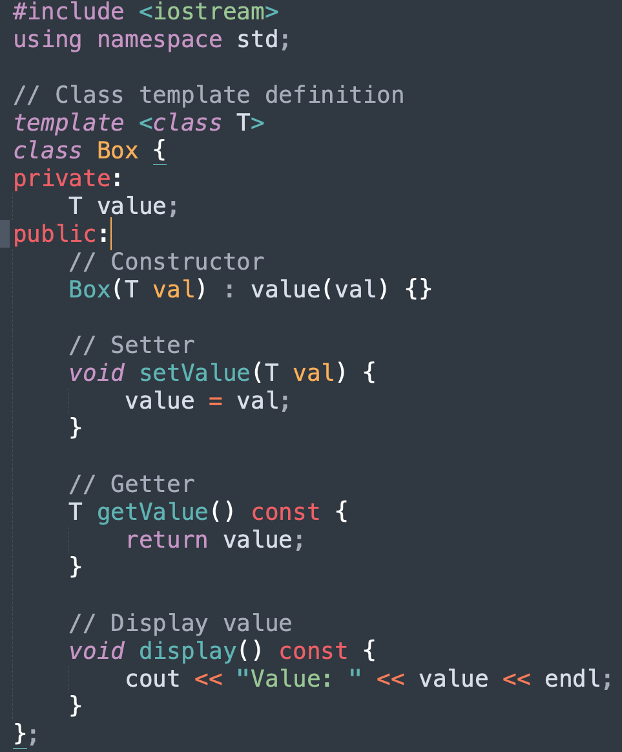
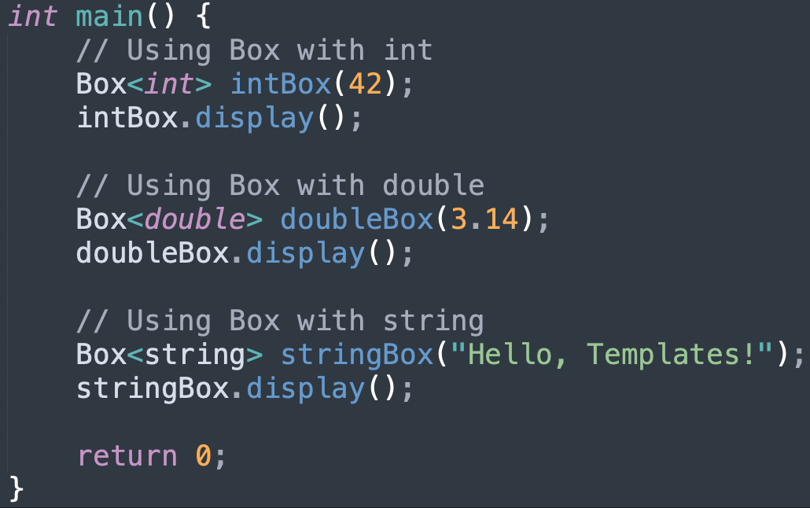
Example

Slide 45
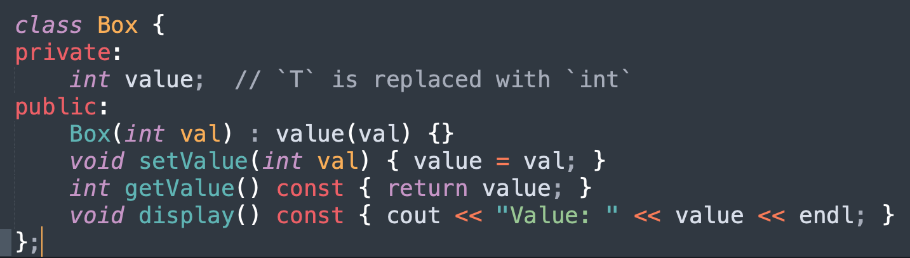
Class templates
Box<int> intBox(42); explanation –
Box<int>: specifies that you are creating an object of the class template Box, with the template type parameter T replaced by int.
The compiler generates a specific version of the Box class where all occurrences of T in the class definition are replaced with int.

Slide 46
When to Use Class Templates
Encapsulation of Data and Behavior:
Class templates are useful when you need to encapsulate data and multiple behaviors in a single object.
Example: A Box<T> class encapsulates a value (T) and provides multiple methods (e.g., setValue, getValue, display).
State Persistence:
Classes maintain state (data members).
If your design requires an object to store data and interact with it over multiple operations, a class template is more appropriate.

Slide 47
When to Use Class Templates
Reusability:
A class template can combine generic types with member functions and data members, making it reusable across multiple scenarios.
Complex Functionality:
When your logic requires multiple functions and interactions (e.g., overloaded operators, multiple methods), a class template helps organize related code.
Inheritance:
Class templates can be extended through inheritance, making them useful in object-oriented designs.

